Slide 1
Wavelength division multiple access
Himanshu Sharma(25)

Slide 2
Multiple access techinques
Multiple access techniques are used to allow a large number of mobile users to share the allocated spectrum in the most efficient manner.
NEED?
As the spectrum is limited, so the sharing is required to increase the capacity of cell or over a geographical area by allowing the available bandwidth to be used at the same time by different users.
And this must be done in a way such that the quality of service doesn’t degrade within the existing users.

Slide 3
WDMA
To allow multiple transmission at the same time, the spectrum is divided into channels (wavelength bands).
WDMA is a technique that uses Wavelength division multiplexing and some protocols by which two or more than two terminals connected to the same transmission medium can transmit over it and to share its capacity over wavelength.

Slide 4
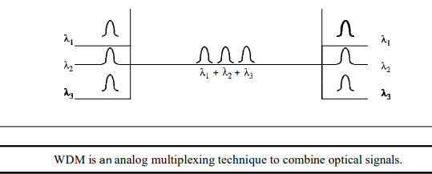
Wavelength Division Multiplexing
Wavelength division multiplexing (WDM) is a technique of multiplexing multiple optical carrier signals through a single optical fiber channel by varying the wavelengths of laser lights. WDM allows communication in both the directions in the fiber cable.

Slide 5
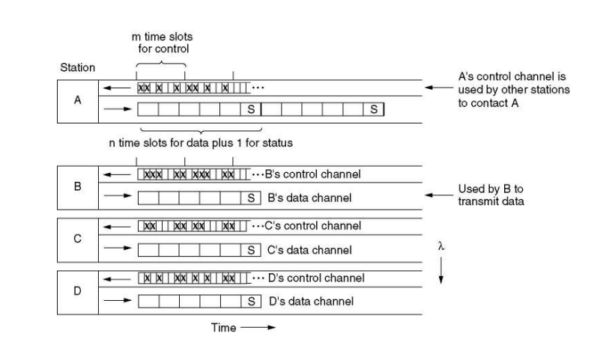
Protocols for WDMA
In this protocol, WDMA, each station is assigned two channels. A narrow channel is provided as a control channel to signal the station, and a wide channel is provided so the station can output data frames.

Slide 6
Reference-http://android.eng.ankara.edu.tr/wp-content/uploads/sites/656/2017/09/Week_7.pdf
https://www.tutorialspoint.com/satellite_communication/satellite_communication_multiple_access_techniques.htm
Thank You
Himanshu Sharma

